Slide 1
R & R Studio Installation for Windows

Slide 2
R & R Studio Installation
Installing R and R Studio on Windows is a straightforward process. Follow these steps to install both:
Install R
Install R Studio
Visit the official R website at: https://posit.co/download/rstudio-desktop/

Slide 3
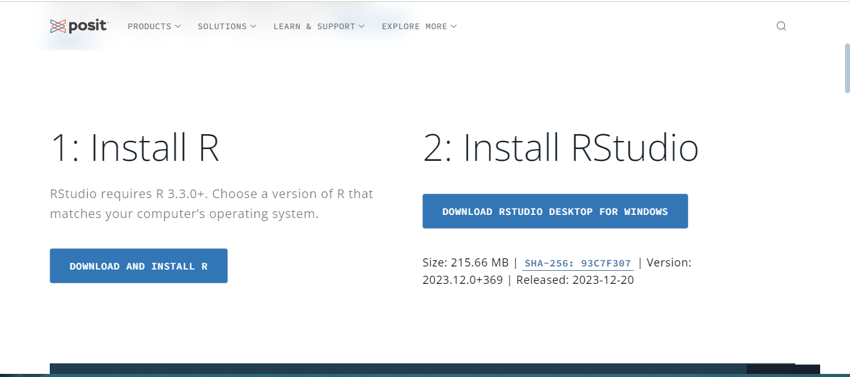
R & R Studio Installation

Slide 4
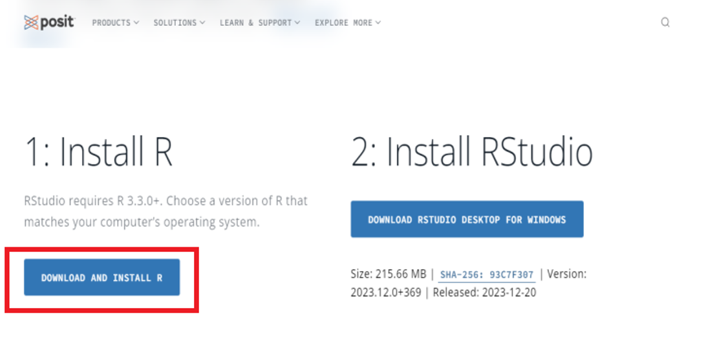
Downloading R

Slide 5
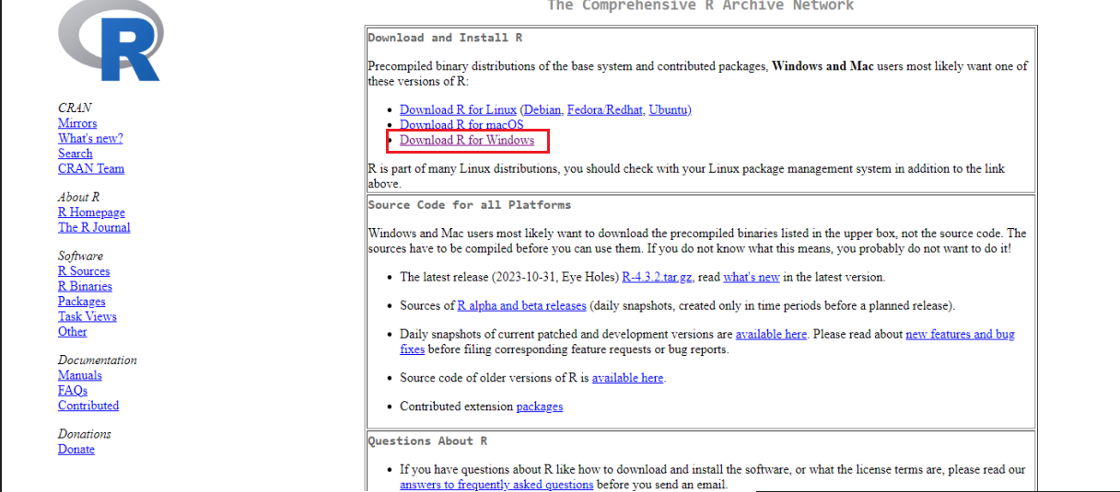
Downloading R

Slide 6
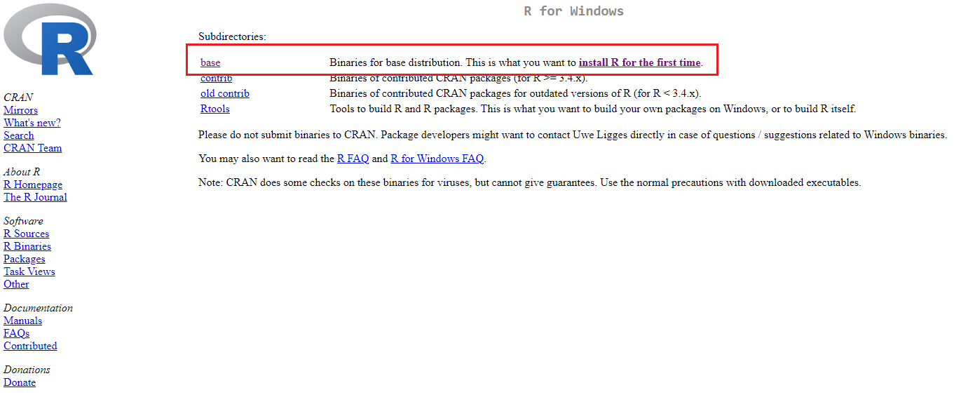
Downloading R

Slide 7
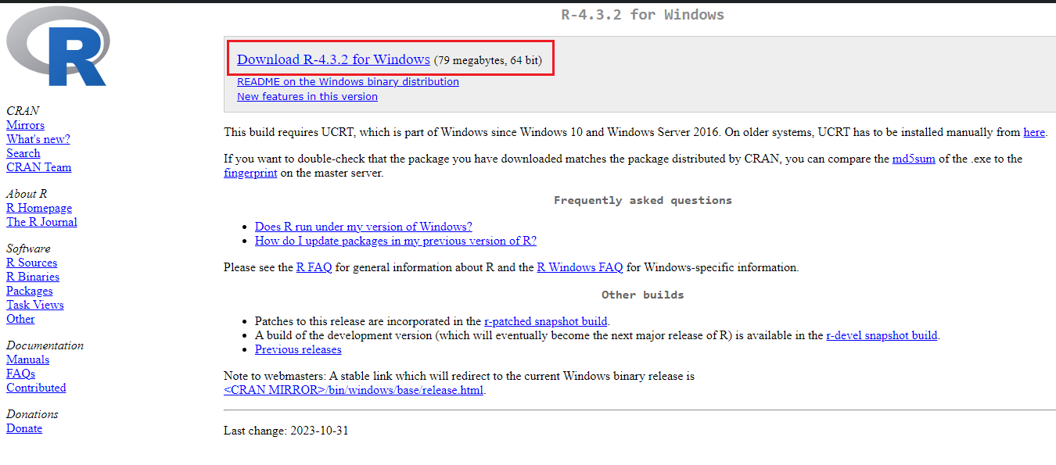
Downloading R

Slide 8
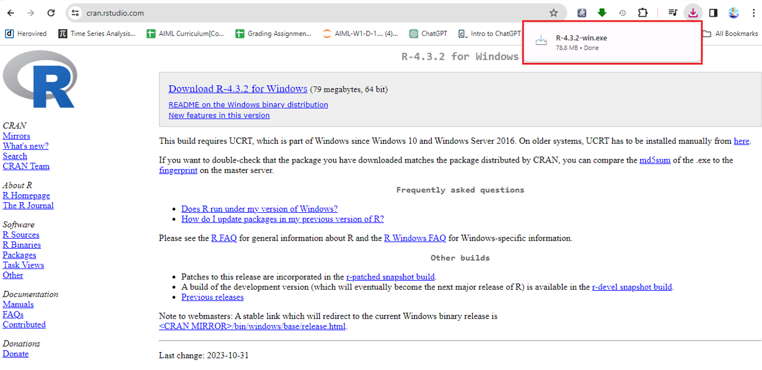
Installing R

Slide 9
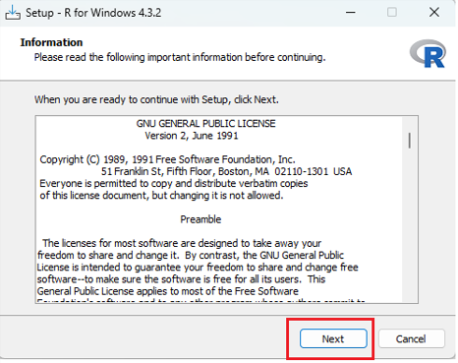
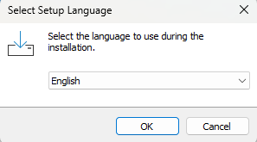
Installing R

Slide 10
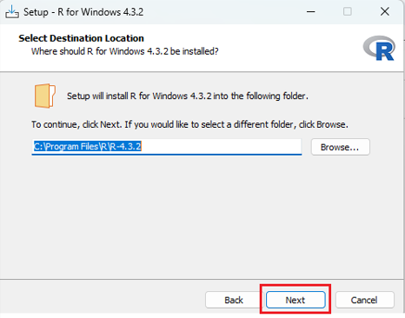
Installing R

Slide 11
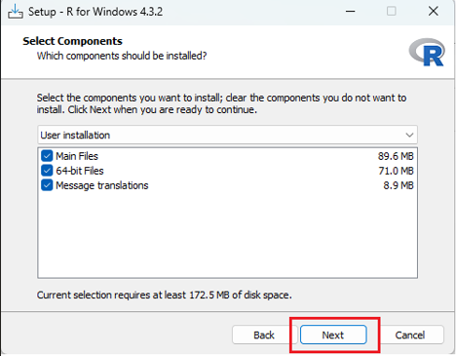
Installing R

Slide 12
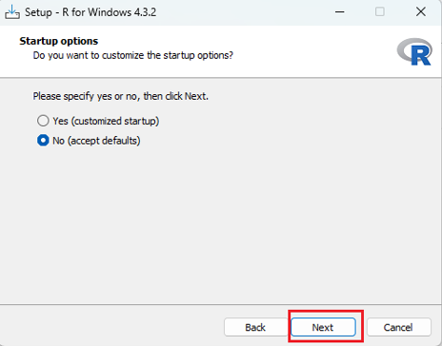
Installing R

Slide 13
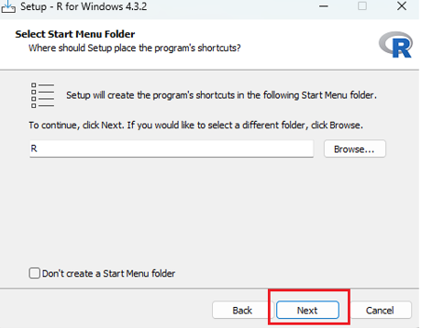
Installing R

Slide 14
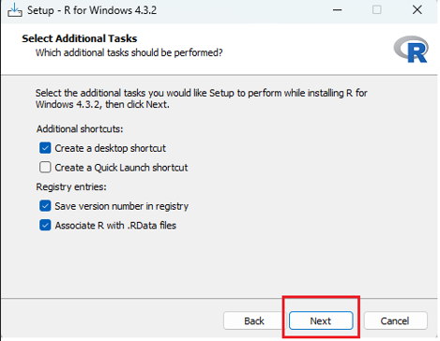
Installing R

Slide 15
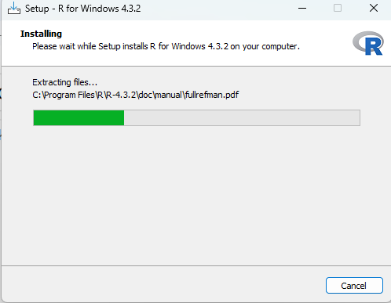
Installing R

Slide 16
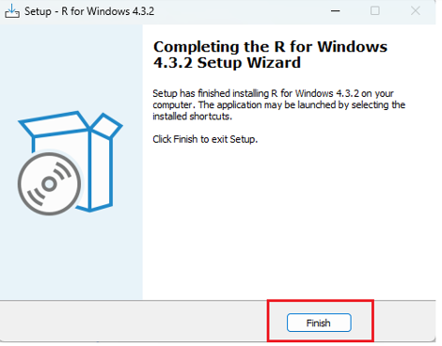
Installing R

Slide 17
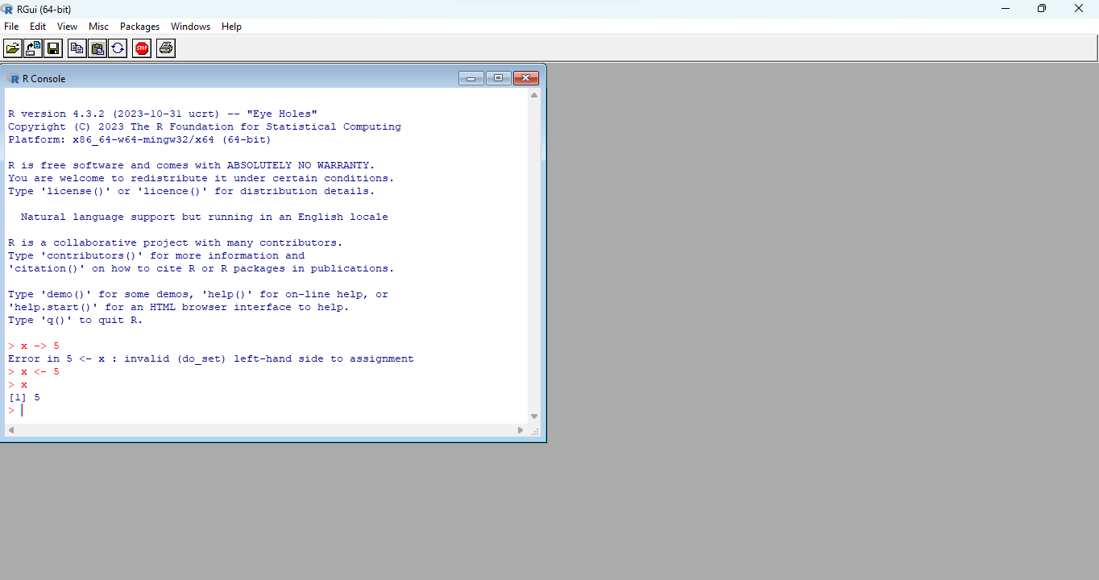
Installing R

Slide 18
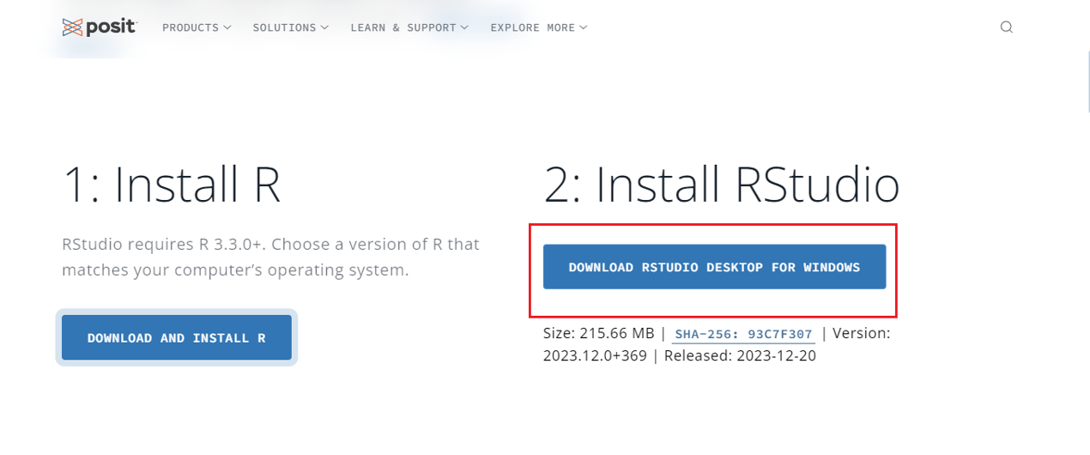
Downloading RStudio

Slide 19
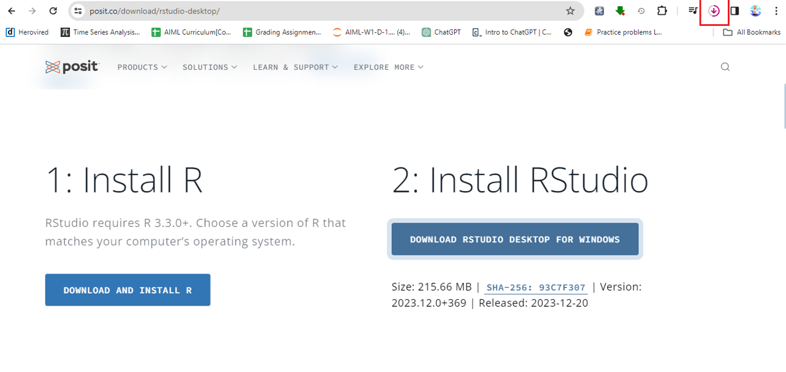
Downloading RStudio

Slide 20
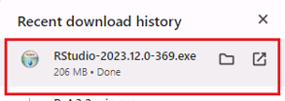
Installing RStudio

Slide 21
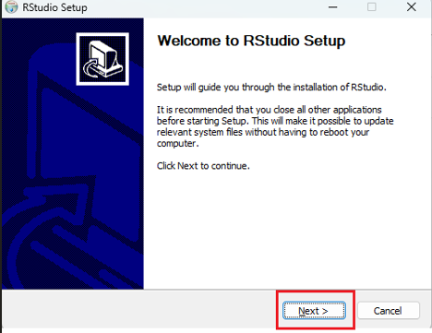
Installing RStudio

Slide 22
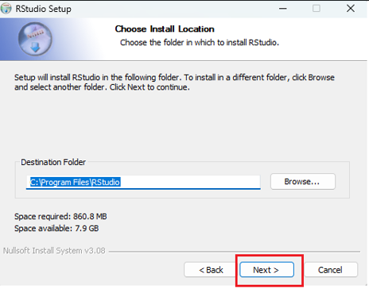
Installing RStudio

Slide 23
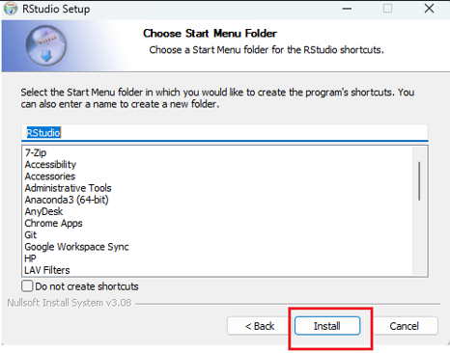
Installing RStudio

Slide 24
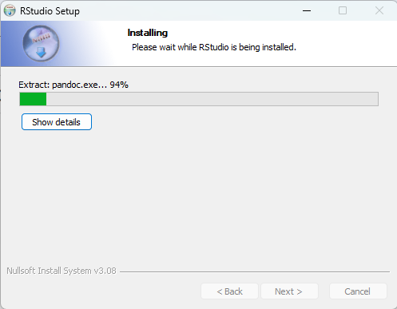
Installing RStudio

Slide 25
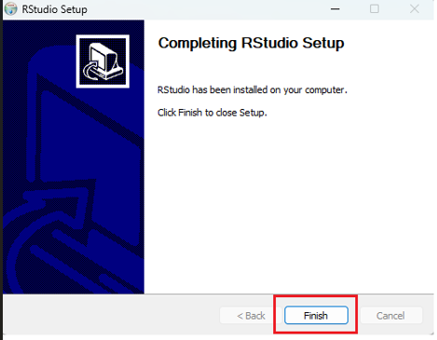
Installing RStudio

Slide 26
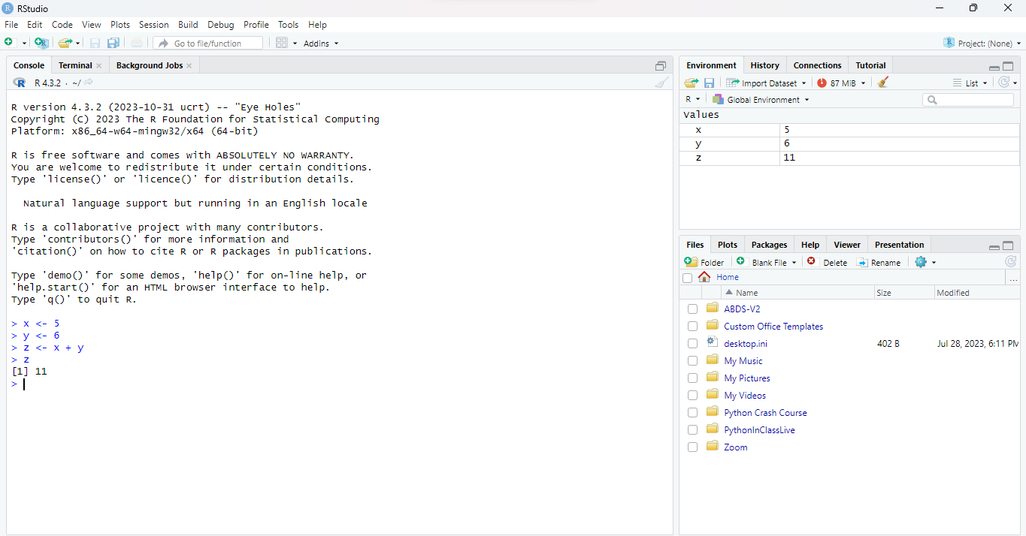
Installing RStudio

Slide 27
Thank You!

